Slide 1
Municipal Corporation Simulator and Visualization Tool

Slide 2
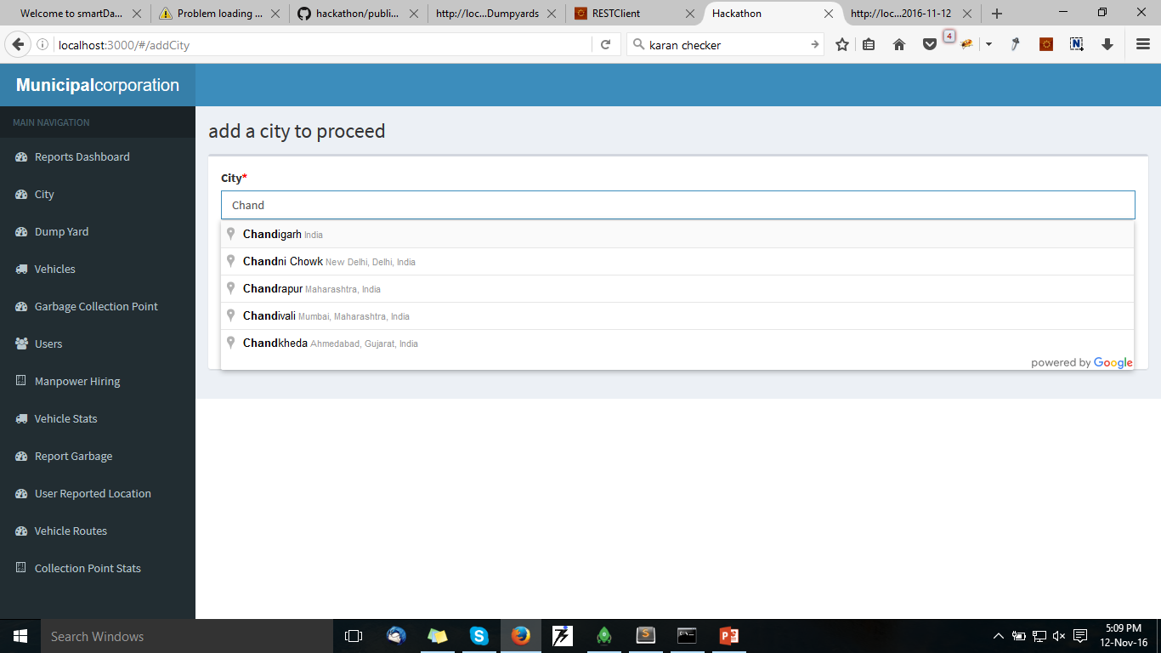
First Step: Add City of Municipal Corporation

Slide 3
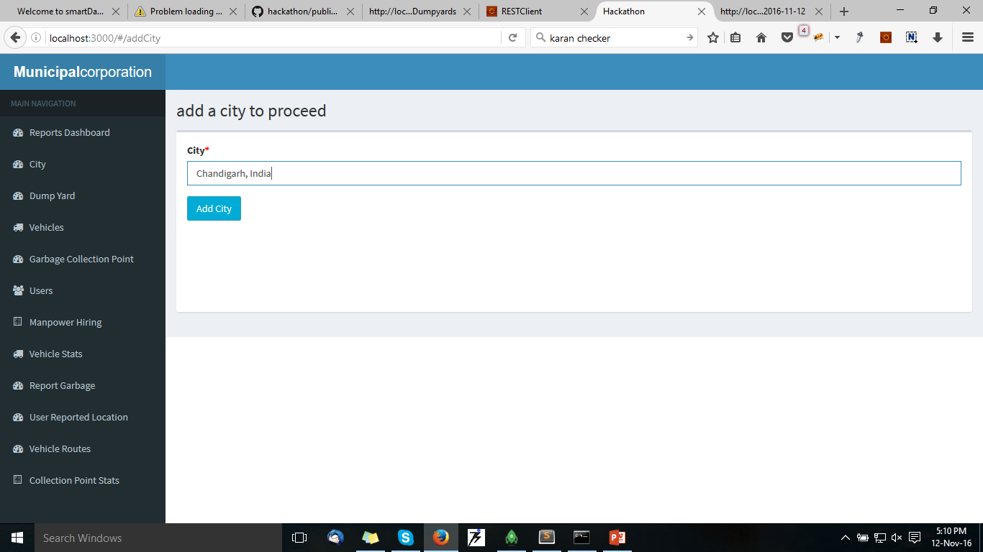
Next Screen: Add City to Proceed

Slide 4
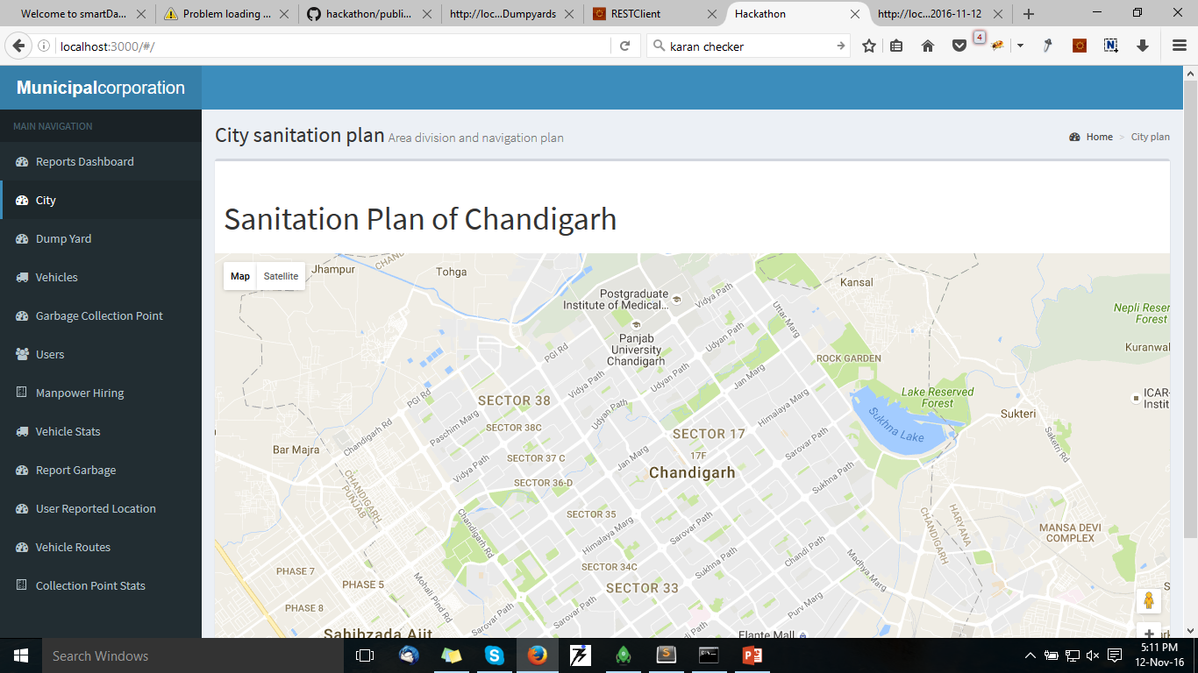
So Chandigarh is the city selected

Slide 5
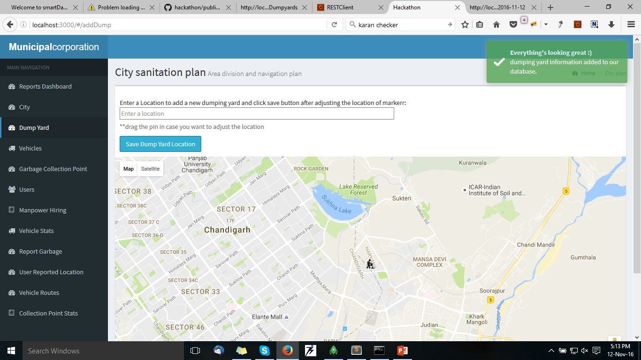
Now Proceed to Add DumpYard by adding location and dragging the map marker for precise location

Slide 6
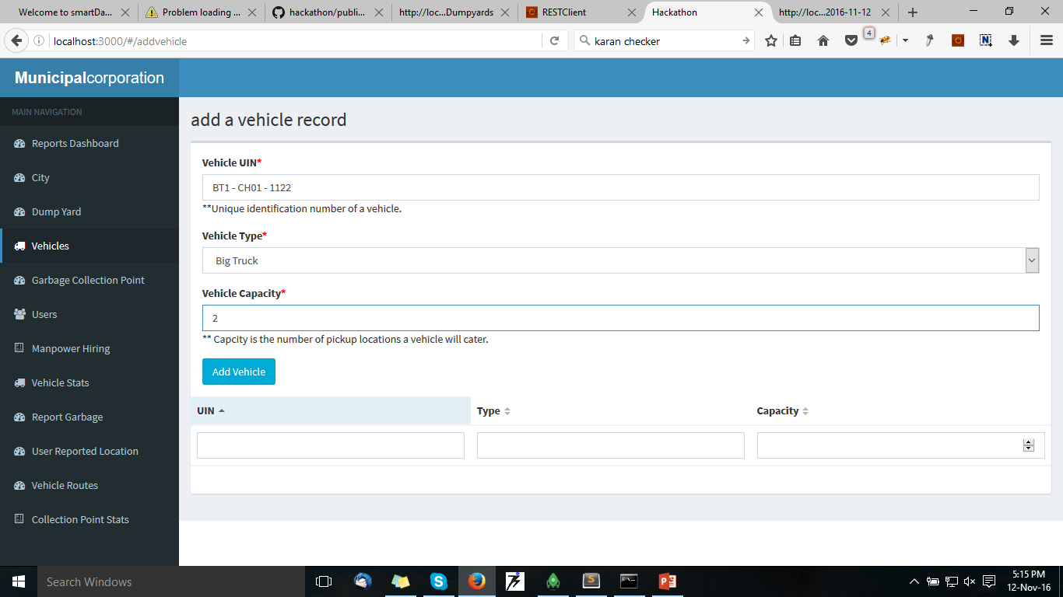
Now Add Vehicles(trucks) for picking up Garbage from within the city

Slide 7
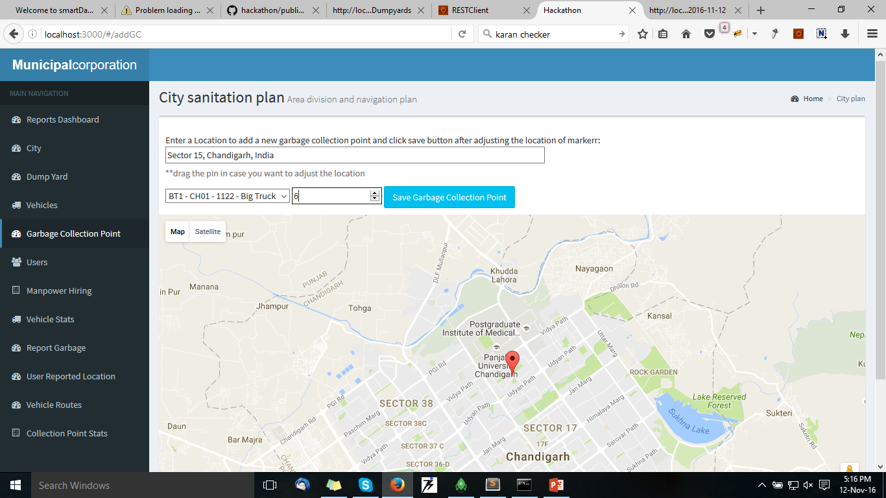
Now add Garbage Collection Points and allocate vehicle and sweeper count to it

Slide 8
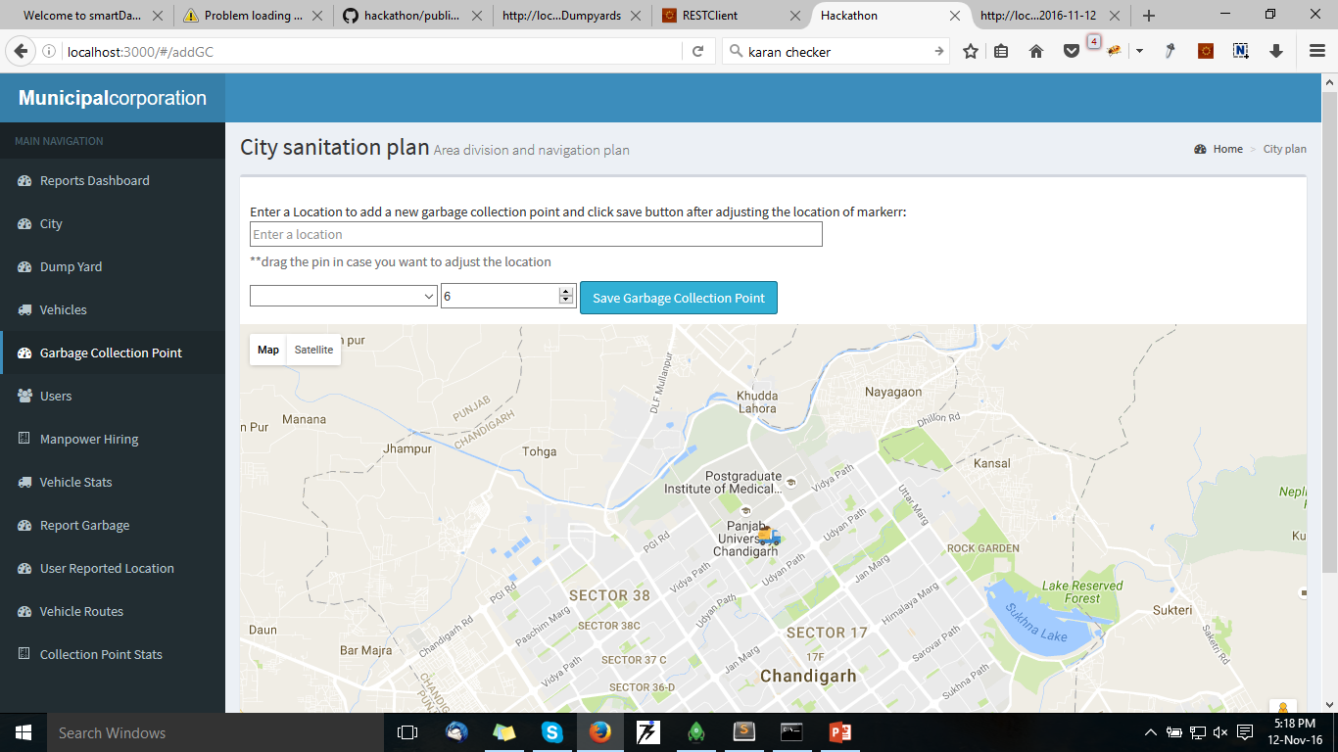

Slide 9

Add Users/Employees (Drivers and Sweepers)

Slide 10
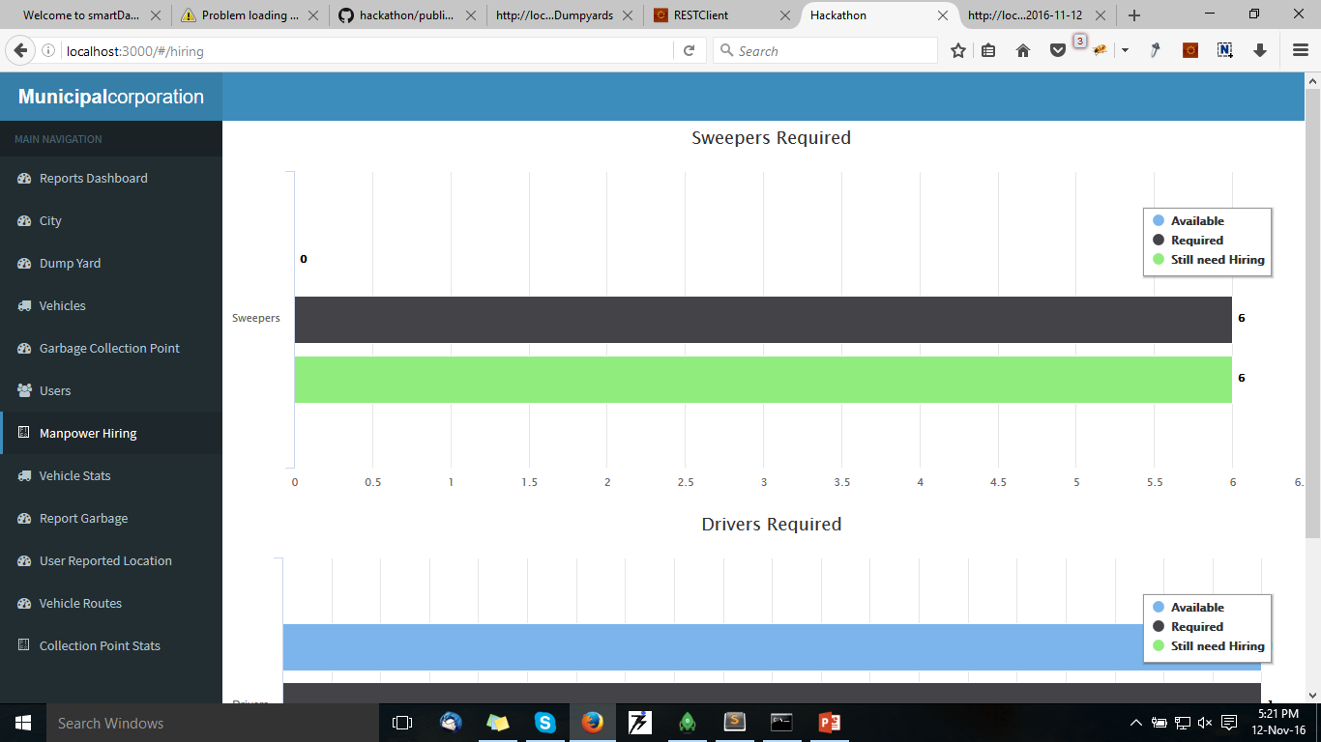
Man Power Hiring Stats

Slide 11
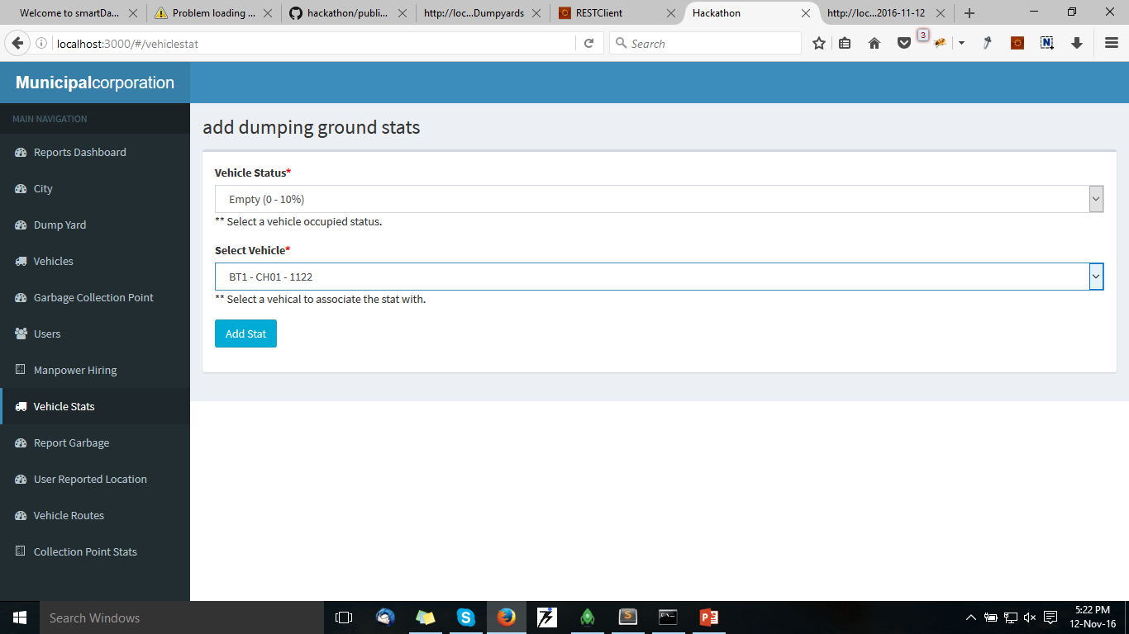
Add Daily Vehicle Stats Collected from Drivers

Slide 12
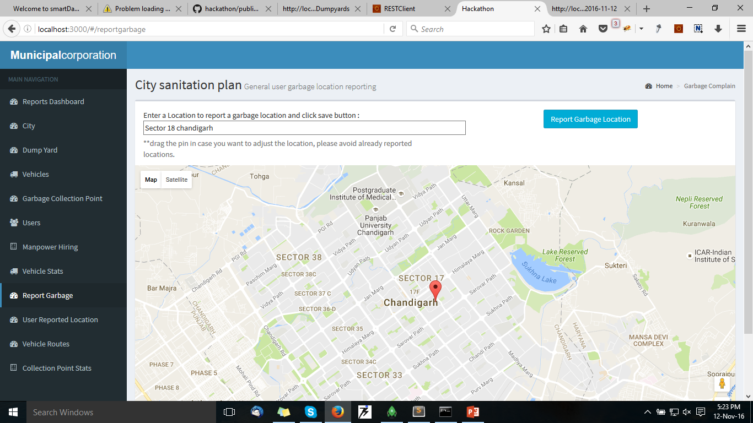
User can report Garbage

Slide 13
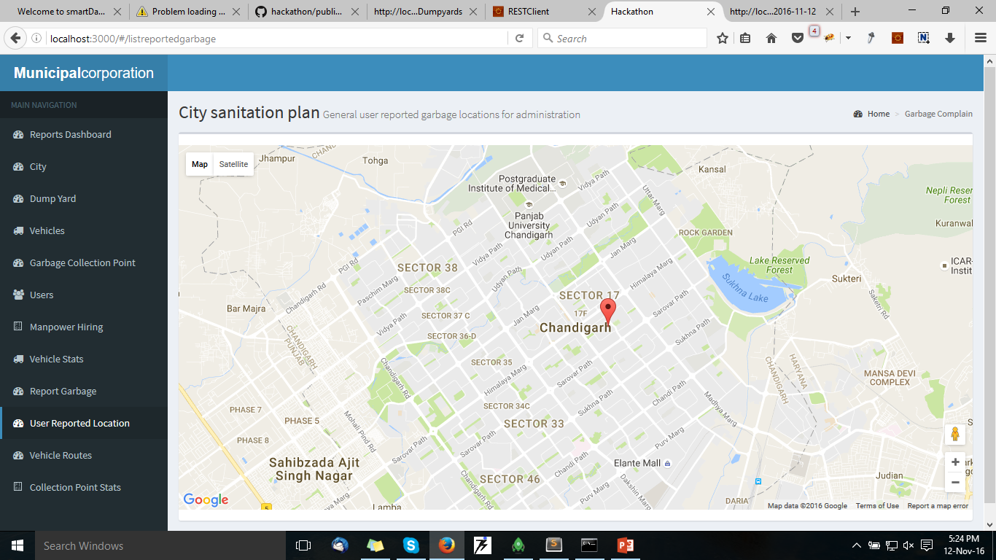
Reported User Garbage Location

Slide 14
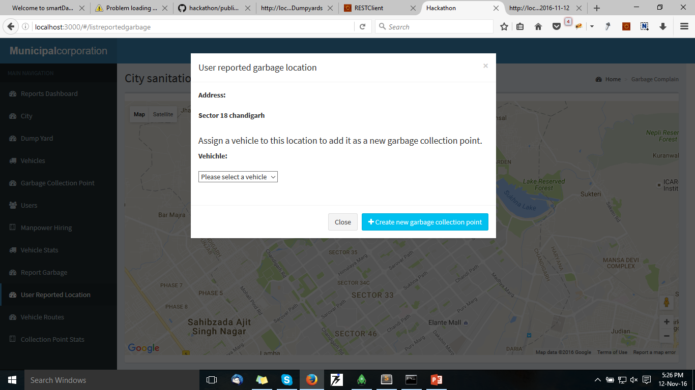
More Option on User Reported Garbage Point

Slide 15
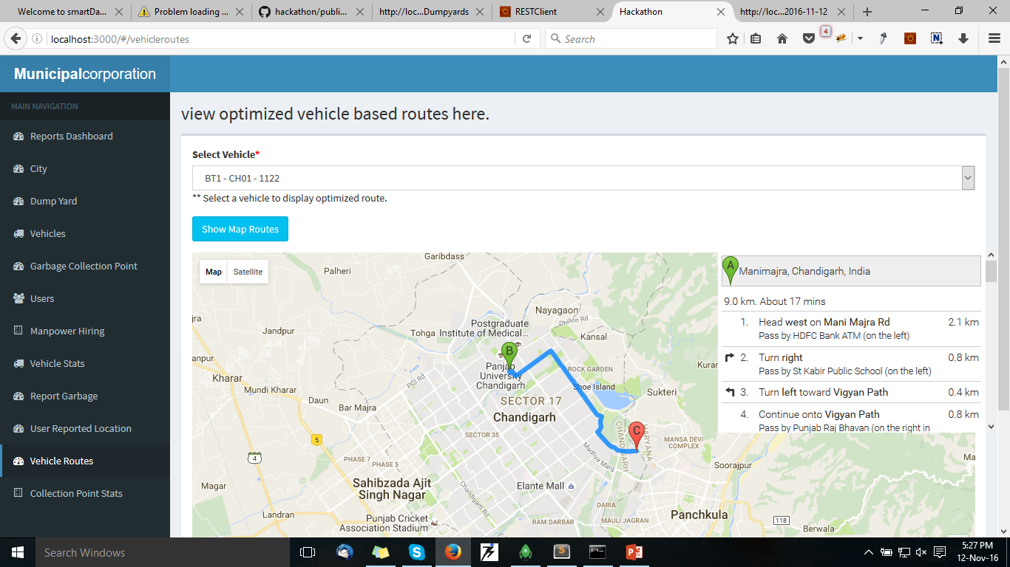
View Optimized Vehicle Routes

Slide 16
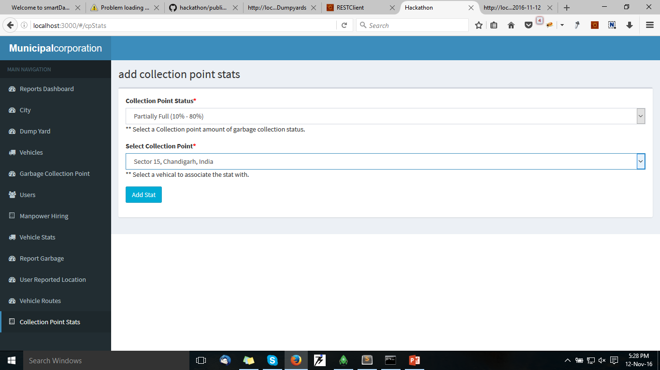
Add Collection Point Stats

Slide 17
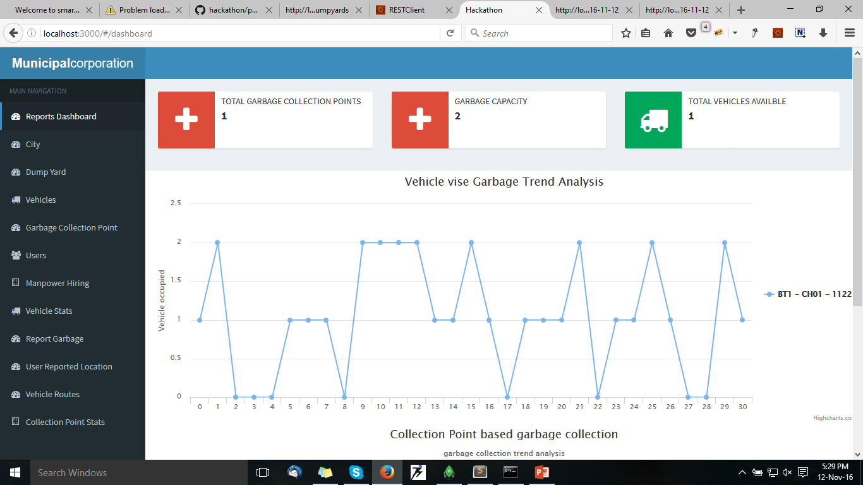
Dashboard

Slide 18
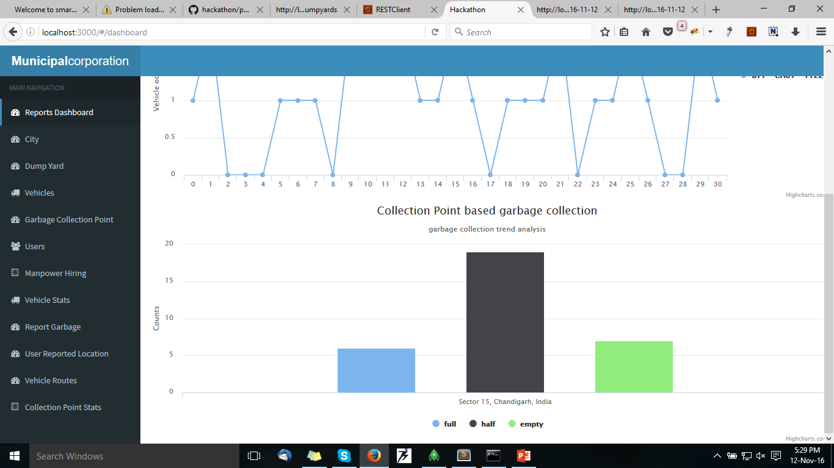
Dashboard Contd…

Slide 19
Thank You
Git url of our Hackthon Efforts
https://github.com/amitchhangani/hackathon.git

